Slide 1
Interactive Andragogical Approaches to Geometry and Statistics for Practitioners
Dr. Brooke Istas
May 2024

Slide 2
Agenda
Review of Andragogy
Line up by size
Test Talks
The Mean Idea
Final Thoughts
Reminder

Slide 3
Will this be on the Test?
College and Career Readiness Standards for Adult Education (CCRSAE)
Key Shifts – Focus, Coherence, and Rigor
Focus were the standards focus, “a mile wide and an inch deep”
Coherence builds on a students understand and extends to new ideas
Rigor is teaching for conceptual understanding, procedural fluency and application with equal emphasis
How?
Adult learners need to be prepared for a critical test, covers K-12
We have them a short time and attendance may not be consistent.

Slide 4
Research shows…
A Stanford researcher, Dr. Boaler
Longitudinal study with students using open-ended projects
Tests were not taken and work was not graded
Questions about processes/procedures in the last weeks before a national standardized test
Results students scored at significantly higher levels compared to the group of students who worked through similar questions to the national exam and took frequent tests (Boaler, 1995, 2015).

Slide 5
What does this mean…
Teaching that is comprised of the three shifts, involves problem-solving, flexible thinking, building on prior knowledge, will prepare students for math exams and real-life math.
Creating math tasks that allow students to use their experience or past understanding through scaffolding
Allowing space to show multiple ways and to reflect

Slide 6
How do we ignore the high-stakes tests?
A test is the driving factor for all our learners

Slide 7
Good News!
You do not need to abandon the 3 key shifts – focus, coherence, and rigor.
You can use standardized problems to help deepen conceptual understanding.
It is not remembering and reproducing the “correct” approach.
It is about making sense of the task and finding an approach that works.
Building confidence to think flexibly
Self-efficacy to attempt questions.
Self-efficacy refers to an individual's belief in his or her capacity to execute behaviors necessary to produce specific performance attainments (Bandura, 1977, 1986, 1997).

Slide 8
Line up by Size
If I wanted to know whose shoe would leave the larger footprint, how could I find out?
Would this be area, perimeter, length or width?
What are some situations where you compare or estimate size?
When you picture the situation, what is being compared – area, perimeter, length or width?

Slide 9
Line up by Size
Put into groups to work through all parts of the activity.
You will have 10-15 minutes to get through as much as you can
Then we will come back together.

Slide 10
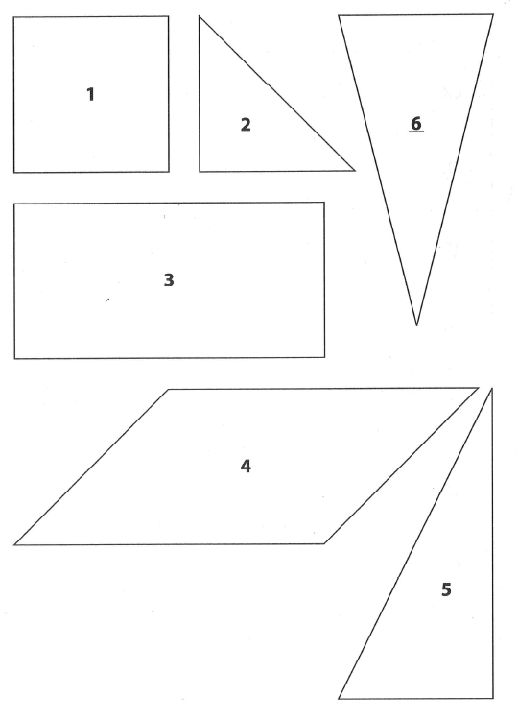
Area and Perimeter
What is the order for Area?
My teacher book had: 2, 1=5=6, 3=4 Does this seem right?
What methods did you or would you try to find out if it is true?
What is the order of Perimeter?
My teacher book had: 2,1,6,5,3,4
2 = 17 cm
1 = 20 cm
6 = 25 cm
5 = 26 cm
3 = 30 cm
4 = 34 cm
What do you notice looking at the two orders – by perimeter and area?
Did this surprise you? Why?

Slide 11
Summary Discussion
What are ways that we compare shapes?
How does looking at perimeter different from looking at area?
Which do you expect to use most frequently: dimensions (length and width), perimeter, area, or angle measurements, etc.?

Slide 12
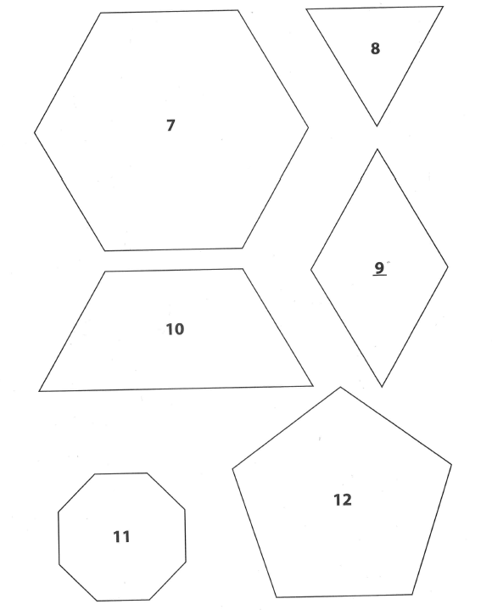
Area and Perimeter

Slide 13
Activity 2: Job Demands and the Caterers’ Question
Back in your groups work together through the 2 activities
Job Demands and the Caterers’ Question
You will have 15 - 20 minutes

Slide 14
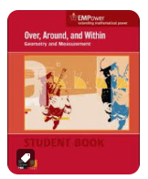
Over, Around, & Within
Activity 5

Slide 15
Test Talk
Enhancing your
presentation
© SABES Mathematics and Adult Numeracy Curriculum & Instruction PD Center

Slide 16
Purposes:
To support learners in extending their learning within the context of test questions
To support learners to think flexibly and creatively in test situations
To support self-efficacy of our learners
NOTE: the purpose is NOT to teach students how complete test questions or question times
Adapted from © SABES Mathematics and Adult Numeracy Curriculum & Instruction PD Center

Slide 17
Process
Select a question
Set expectations
Assign students a question
Give time to think
Facilitate strategy sharing
Share additional strategies
Ensure students have a strategy they like
Encourage notetaking
Facilitate a wrap-up discussion
© SABES Mathematics and Adult Numeracy Curriculum & Instruction PD Center

Slide 18
Park Playground
© SABES Mathematics and Adult Numeracy Curriculum & Instruction PD Center

Slide 19
Student Page
My Strategy:
My Favorite Strategy:
I like this strategy because:
© SABES Mathematics and Adult Numeracy Curriculum & Instruction PD Center

Slide 20
Sketch a new diagram for better estimate
© SABES Mathematics and Adult Numeracy Curriculum & Instruction PD Center

Slide 21
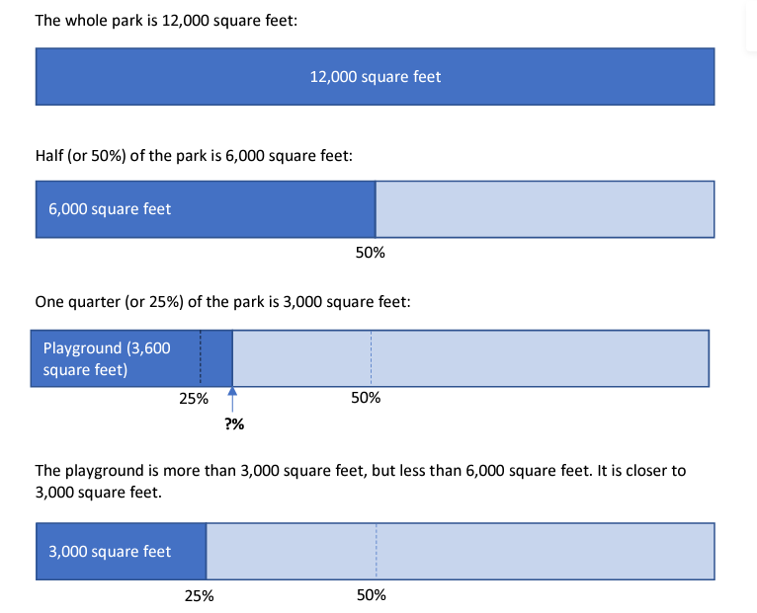
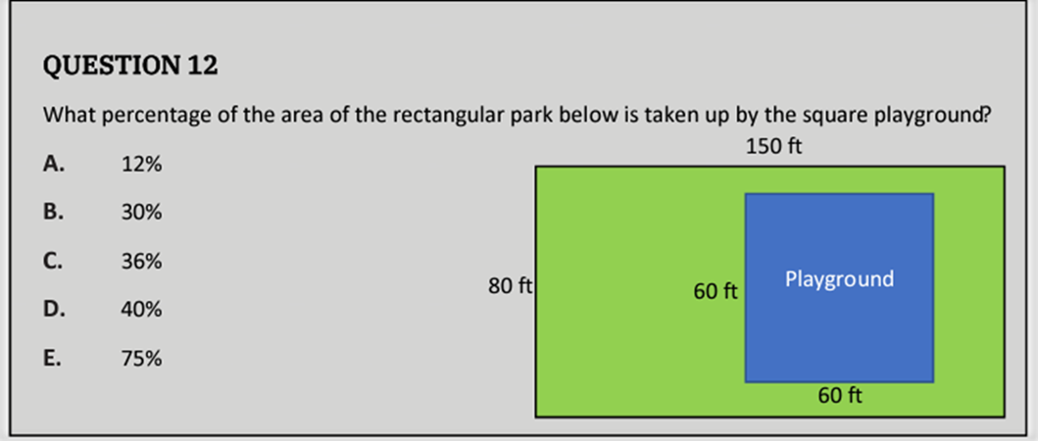
Areas and Estimate with benchmarks
© SABES Mathematics and Adult Numeracy Curriculum & Instruction PD Center

Slide 22
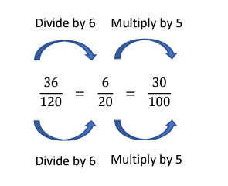
Reason about equivalent fractions
There are lots of other ways to get to a denominator of 100.
How many other ways can you think of?
What do you think your students would likely do?
Starting with the fraction, $\frac{3600}{12000}=\frac{36}{120}$
© SABES Mathematics and Adult Numeracy Curriculum & Instruction PD Center

Slide 23
Test Talks
Select a question
Set expectations
Assign students a question
Give time to think
Facilitate strategy sharing
Share additional strategies
Ensure students have a strategy they like
Encourage notetaking
Facilitate a wrap-up discussion
Student-centered teaching
Andragogy
Self-directed
Problem-solvers
Reflection

Slide 24
Statistics
Basic Understanding needed:
Meaning of average (mean)
Multiple strategies to understand mean
© SABES Mathematics and Adult Numeracy Curriculum & Instruction PD Center

Slide 25
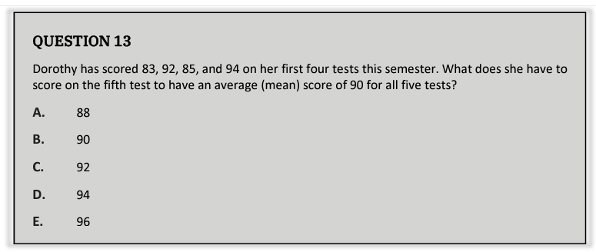
Student Page
© SABES Mathematics and Adult Numeracy Curriculum & Instruction PD Center

Slide 26
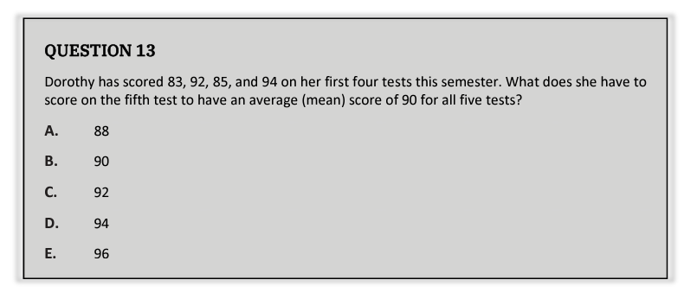
Estimate
Mean is a way to find the “middle”
Observe the 2 test scores are above 90 and 2 test scores are below 90
The 2 below are further away from 90 than the above one
Her current average is less than 90
She will need a score that is greater than 90
© SABES Mathematics and Adult Numeracy Curriculum & Instruction PD Center

Slide 27
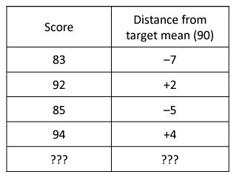
Think about distances from the target mean
Or Diagram with a table
© SABES Mathematics and Adult Numeracy Curriculum & Instruction PD Center

Slide 28
Make equal piles
© SABES Mathematics and Adult Numeracy Curriculum & Instruction PD Center

Slide 29
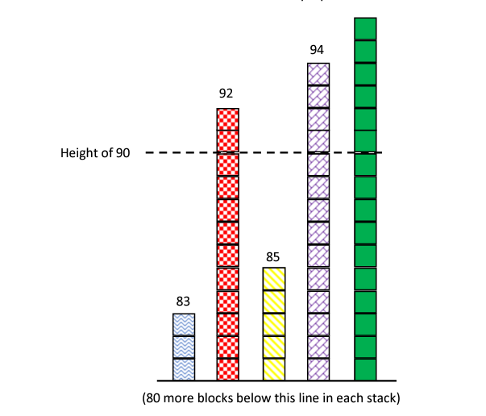
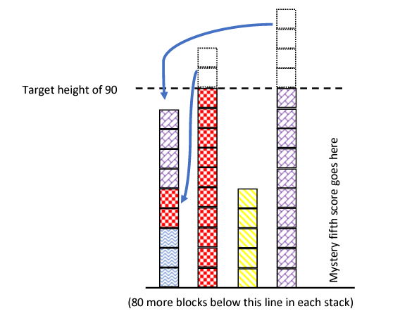
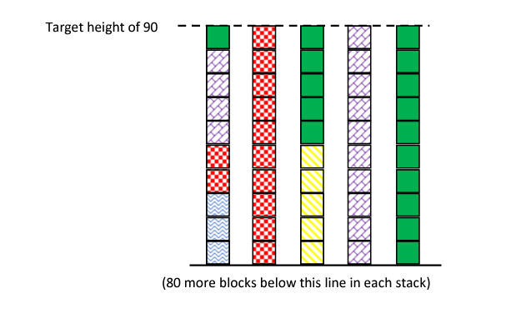
Make equal piles
© SABES Mathematics and Adult Numeracy Curriculum & Instruction PD Center

Slide 30
Find the total
© SABES Mathematics and Adult Numeracy Curriculum & Instruction PD Center

Slide 31
Guess and check
Use an estimate to inform their first guess
The, use the results of each guess to inform the next.
© SABES Mathematics and Adult Numeracy Curriculum & Instruction PD Center

Slide 32
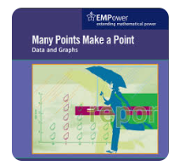
The Mean Idea
In groups, you will have 10 – 15 minutes to discuss the problems
Consider the multiple ways of understanding mean and try to incorporate one.
Lesson 7: The Many Points Make a Point

Slide 33
Final Thoughts:
Math learning is not remembering and reproducing the “correct” approach.
Math is about making sense of the task and finding an approach that works.
Allow students the time to build confidence to think flexibly.
Creating life-long learners and not just mimickers
Not all items on tests, e.g. items with unfamiliar vocabulary or notation.
This WILL happen because of our limited time with our learners.

Slide 34
Save the Date: June 13 and 14, 1 – 3:30 PM
Session 5: Growth Mindset Mastery: Empowering Adult Basic Mathematics Instructors
This session will be our last time together in this institute.
Don’t miss it.

Slide 35
Thank you
Dr. Brooke Istas
brooke.istas@cowley.edu

