Slide 1
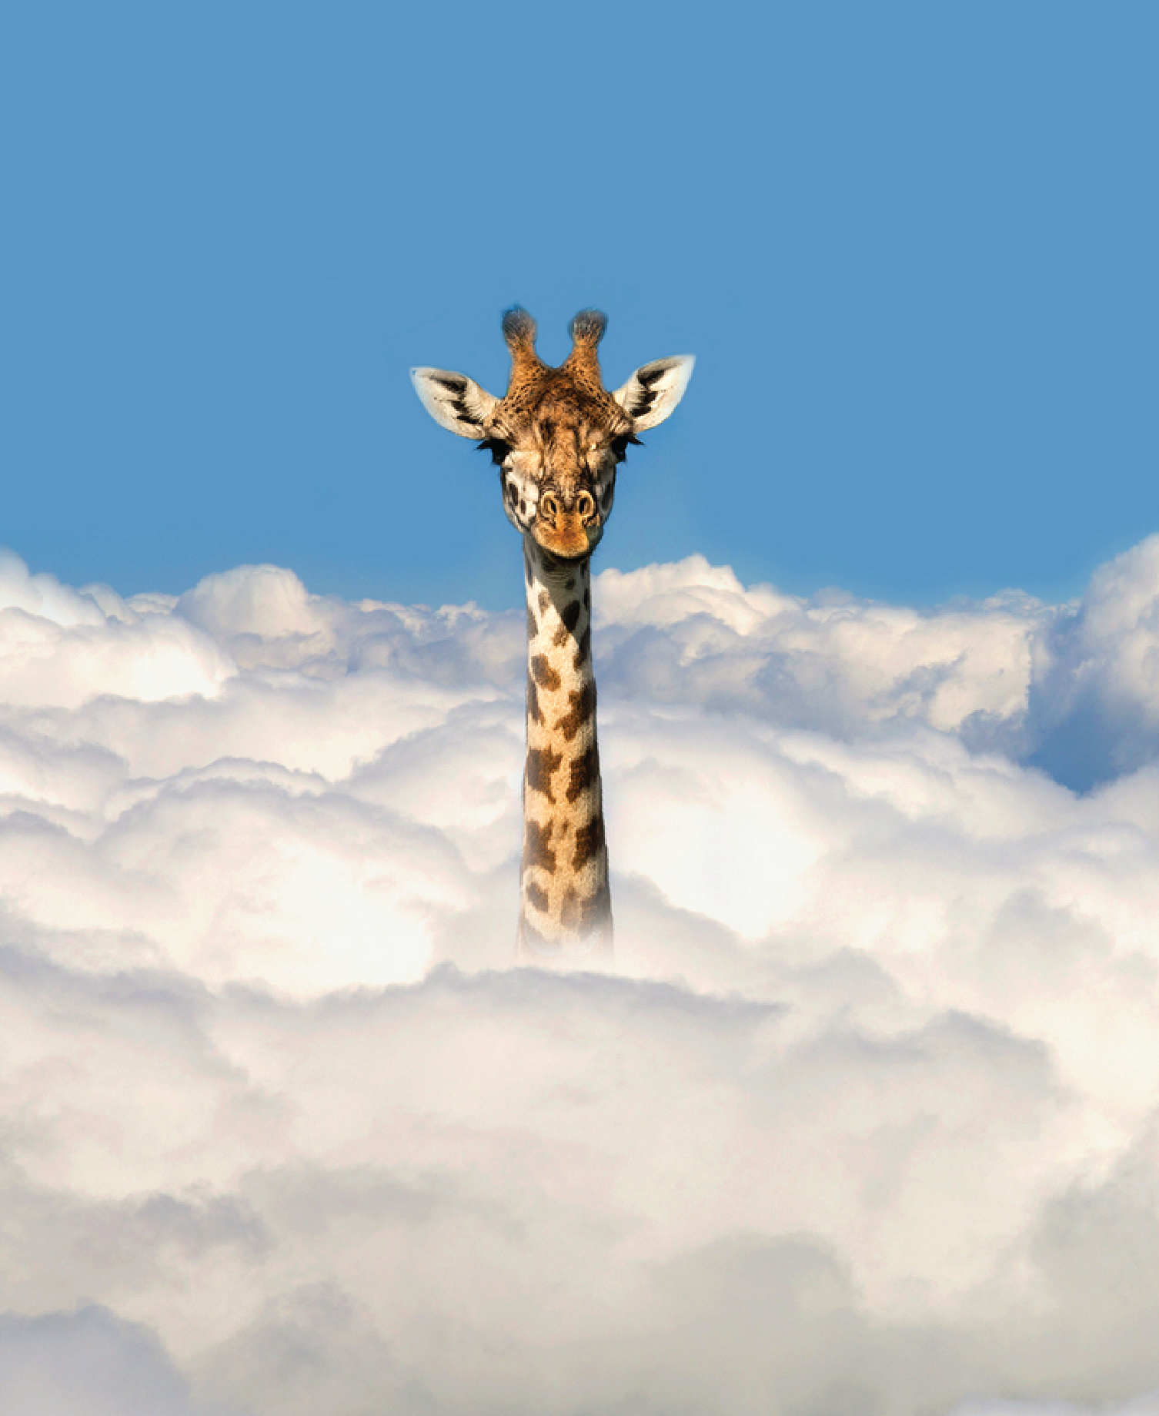
Growth Mindset Mastery
Empowering Adult Basic Education Mathematics Instructors

Slide 2
Please download and install the Slido app on all computers you use
What things have you tried from these institutes (or were inspired from these institutes) in your classrooms?
ⓘ Start presenting to display the poll results on this slide.

Slide 3
Welcome
This is our last institute!
Are there any new participants? If so, introduce yourself to everyone.

Slide 4
Dr. Brooke Istas
Have been teaching in adult education for almost 20 years
Degrees in mathematics and adult education
I am an adult numeracy researcher
LINCS Math and Numeracy Community of Practice Moderator
Adult Numeracy Network Secretary

Slide 5
Thomas H. Palmer’s Teacher’s Manual (1840)
“Tis a lesson you should heed, Try try again.
If at first you don’t succeed, Try,try again.”

Slide 6
William Edward Hickson popularized it is his book, “The singing Master.” (1836)
A Moral Song
“Tis a lesson you should heed, Try again.
If at first you don’t succeed,
Try again.
Then your courage should appear;
For if you will persevere,
You will conquer, never fear,
Try again.”

Slide 7
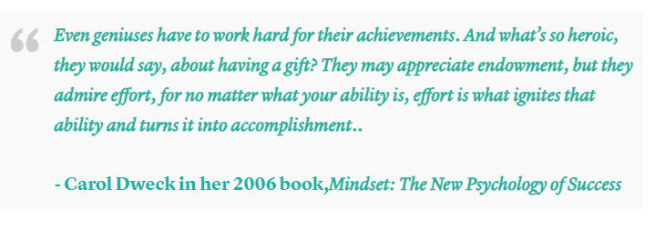
Mindset
What do these quotes remind us?
Always room for improvement and encouraging us to persevere
Growth Mindset – we believe our intelligence and abilities can be developed over time (Dweck, 2007).

Slide 8
Activity One
Do you know what the following words mean?
Risks, Mistakes, Success, Courage, and Persistence
In the chat, you will be given a link to a Google Document. Each word is listed.
I will give you 15 minutes to write or you may draw on paper you have (you will share it). You may share a story, a list of words, examples, whatever you wish about the each of these words.
You may turn off your cameras for this activity.

Slide 9
What do these People have in Common?
Walt Disney
Thomas Edison
Oprah Winfrey
Albert Einstein
Abraham Lincoln
Michael Jordan
Elvis Presley
Henry Ford
Steven Spielberg
Stephen King
J.K. Rowling

Slide 10
What do these People have in Common?
Vera Wang
Beyonce
Elon Musk
Bill Gates
Sylvester Stallone
Muhammed Ali
Cesar Chavez
Warren Buffet

Slide 11
What do these People have in Common?
Rosa Parks
Malala Yousafzai
Martin Luther King, Jr.
Mahatma Gandhi
Harriet Tubman
Eleanor Roosevelt
Queen Elizabeth II
Nelson Mandela

Slide 12
Research
Dweck, Duckworth, and Boaler

Slide 13
History of Mindset
Cognitive Psychology has been studying mindset since the early 1900s.
Although, most people think of Carol Dweck when we say mindset now.
How did it begin?
Dweck’s 6th grade classroom
Mrs. Wilson, organized seats by IQ scores
Dweck had a high IQ = privileges
Low IQ = none
Notes:
Dweck notes that, on one hand, she didn’t think IQ scores derived from one test could be that important.⁴ On the other hand, all students want to succeed in the models presented to them. In Dweck’s school, academic success was associated with a high IQ score. In fact, she was told that her school was counting on her to get the highest score in a state-wide chemistry test. While she scored 99 out of 100, Dweck believes that the pressure she experienced from her school’s glorification of IQ was a pivotal point, inspiring her future work.

Slide 14
Carol Dweck
Early researcher, Dweck was curious about human interactions
Framework in which people understand and respond to the world
In one study, Dweck investigated the types of praise teachers would offer their students.
Notes:
As a young researcher, Dweck was fascinated by the fact that some children faced challenges with calmness and confidence, while others shrunk back in defeat.⁶ Specifically, Dweck’s use of mindset referred to the frameworks in which people understand and respond to the world.¹

Slide 16
Carol Dweck
Determined to figure what the “secret sauce” as to why some students chose challenging problems while others did not
Mindset: The New Psychology of Success was published in 2006
Misinterpretations of Dweck’s work (3 Common misconceptions)
False growth mindset – oversimplification of the meaning
Growth mindset it solely based on praising and rewarding effort
Believing and saying you have a growth mindset will result in success
Dweck has said that it is difficult to develop a growth mindset
Notes:
In her attempts to decode the so-called “special sauce” that drove some students to be excited in the face of a challenge, Dweck considered the terms “fixed mindset entity theory” and “incremental theory.”⁷ Realizing how clunky and ambiguous these terms sounded, Dweck came up with the more appealing labels of growth and fixed mindsets in the early 2000s. Dweck’s Mindset: The New Psychology of Success was published in 2006 to present her framework to the general population and to help people fulfill their full potential.¹
Controversies
Dweck’s ideas behind the growth and fixed mindsets have become a bit distorted in their translations.¹³ As a result, Dweck has addressed three common misconceptions, with the first being a “false growth mindset,” which is when people say they have a growth mindset when they do not. Essentially, the growth mindset’s popularity has led it to be perceived as simpler than it really is.⁶
People tend to confuse having a growth mindset with being open-minded or having a positive outlook on life, which are ultimately qualities that people believe they have always had.¹³ A teacher might applaud a child for putting in effort on a failed test, because they believe that doing so will promote a growth mindset.6 However, this sort of empty praise is one of the issues that growth mindsets were developed to overcome.
The issue of the “false growth mindset” is tied to another common misconception, which is that growth mindsets are solely about praising and rewarding effort.¹³ While support is important, outcomes matter too. Rather than just praising the effort, Dweck suggests that people praise the effort that led to the outcome or learning progress, encouraging the person to find another learning strategy.⁶ In the context of school, students need to know that they need more than just effort when they’re stuck: they need to know when to ask for help and when to use certain resources.
The third misconception is that simply saying and believing you have a growth mindset will result in success.¹³ A company that has a mission statement with values of growth, empowerment, and innovation is great, but it doesn’t mean anything if the company doesn’t implement policies to make those growths and empowerment attainable. Dweck emphasizes the importance for organizations to encourage risk-taking and support collaboration to truly embody a growth mindset.

Slide 17
Angela Duckworth
Researcher of Grit
Grit is the ability to sustain effort and interest over an extended period of time despite facing challenges, setbacks, or failures (Duckworth, 2016).
Key Factors of Grit
Interest and Passion
Practice and Deliberate Practice
Purpose and Meaning
Resilience and Growth Mindset
Supportive Environment
Goal Setting and Self-regulation
Notes:
Angela Duckworth outlines several key factors in the development and cultivation of grit:
Interest and Passion: Duckworth emphasizes the importance of developing a strong interest and passion for a particular goal or activity. Passion provides the motivation and drive necessary to sustain effort and perseverance over time.
Practice and Deliberate Practice: Grit is developed through consistent practice and deliberate efforts to improve. Duckworth highlights the role of deliberate practice, which involves focused and purposeful practice aimed at addressing weaknesses and pushing one's limits.
Purpose and Meaning: Having a sense of purpose and meaning behind one's goals can fuel grit. Individuals who see their goals as meaningful and aligned with their values are more likely to persevere in the face of challenges and setbacks.
Resilience and Growth Mindset: Developing resilience is essential for cultivating grit. Duckworth emphasizes the importance of bouncing back from failures and setbacks, viewing them as opportunities for growth rather than obstacles. A growth mindset, which entails believing that abilities can be developed through effort and perseverance, is also crucial for building grit.
Supportive Environment: Grit is often nurtured in environments that provide support, encouragement, and opportunities for growth. Having mentors, role models, and supportive peers can help individuals stay motivated and focused on their goals.
Goal Setting and Self-regulation: Setting clear, challenging goals and effectively managing one's time and resources are important aspects of cultivating grit. Duckworth suggests that individuals with grit are skilled at self-regulation, maintaining focus and discipline in pursuit of their goals.

Slide 18
Similarities and Differences
Similarities
Focus on Psychological Traits
Emphasis on Effort and Persistence
Differences
Focus on Research
Measurement and Assessment
Theoretical Framework
Both influenced the next researcher, Jo Boaler

Slide 19
Jo Boaler
Emphasizes the importance of cultivating a growth mindset in mathematics education
Research utilizes both Dweck’s Mindset Theory and Duckworth’s Grit Theory
Implications for Mathematics Education
Supportive learning environment
Students are empowered to:
Take risks,
Make mistakes
Engage deeply with mathematical concepts
Promotes resilience, motivation, and achievement

Slide 21
Adult Education Research
Limited research
Teaching adults
Come from diverse backgrounds and experiences
Changing mindsets can be difficult
This Photo by Unknown Author is licensed under CC BY

Slide 22
Metacognition and UDL
Metacognition and Universal Design for Learning
Both frameworks promote: Individualized Learning, Promoting Self-Regulated Learning, and flexible learning environments
Share common goals of promoting inclusive and learner-centered
Metacognition: 1)Planning, 2) Monitoring, and 3)Reflection
UDL: Provide, Offer, and Support Multiple Means of Representation, Engagement, and Expression
This Photo by Unknown Author is licensed under CC BY-SA-NC
Notes:
he connection in the metacognition process lies in how individuals use their awareness and understanding of their own cognitive processes to regulate and control their learning.
Planning: In the planning phase of metacognition, individuals connect their learning goals with the strategies they plan to use to achieve them. They consider factors such as the nature of the task, their own strengths and weaknesses, and the resources available to them. By making these connections, individuals can create a roadmap for their learning journey, setting themselves up for success.
Monitoring: During the monitoring phase, individuals continuously connect their current progress with their intended learning outcomes. They assess their understanding, evaluate their performance, and compare it against their goals. By making these connections, individuals can identify any discrepancies between their current state and their desired state, prompting them to adjust their strategies as needed.
Reflection: In the reflection phase, individuals connect their past learning experiences with their future learning endeavors. They consider what worked well, what didn't, and what they can do differently next time. By making these connections, individuals can extract valuable insights from their experiences, inform their future actions, and continually improve their learning processes.
Here are three strategies for utilizing Universal Design for Learning (UDL) in educational settings:
Provide Multiple Means of Representation:
Offer content in multiple formats, such as text, audio, video, and graphics, to accommodate diverse learning preferences and abilities.
Use diverse instructional materials and resources to present information in different ways, allowing students to access content through their preferred modalities.
Provide scaffolds and supports, such as graphic organizers, visual aids, and captions, to help students understand and process complex information.
Offer Multiple Means of Action and Expression:
Allow students to demonstrate their understanding and express their ideas in various ways, such as through writing, speaking, drawing, or creating multimedia presentations.
Provide flexible options for completing assignments and assessments, such as offering choice boards, project-based assessments, or alternative formats for exams.
Offer assistive technologies and tools, such as speech-to-text software, word prediction programs, or graphic organizers, to support students with diverse needs in expressing themselves effectively.
Support Multiple Means of Engagement:
Foster a supportive and inclusive learning environment where students feel valued, respected, and motivated to learn.
Provide opportunities for active participation and collaboration, such as group discussions, cooperative learning activities, and peer interactions.
Incorporate students' interests, preferences, and cultural backgrounds into instruction to increase engagement and relevance.
By implementing these strategies, educators can create more inclusive learning environments that support the diverse needs and preferences of all students, leading to increased engagement, motivation, and achievement.

Slide 23
Activity 2
Dollar Bill | Cat lives
Dice | Bowling pins
Tricycle | Football team
Four-leaf clover | Dozen eggs
Hand | Unlucky Friday
Six-pack | Valentine’s Day
Seven-Up | Quarter Hour
Octopus
Show a list
You will have 45 seconds
I want you to count all of the vowels in the text.
Ready?

Slide 24
Activity 2 – How did it go?
Dollar Bill | Cat lives
Dice | Bowling pins
Tricycle | Football team
Four-leaf clover | Dozen eggs
Hand | Unlucky Friday
Six-pack | Valentine’s Day
Seven-Up | Quarter Hour
Octopus
Close your eyes and try to recall all the words and phrases that you just saw
List as many as you can.
Now look at the original list
Write down the number of items you were able to accurately remember
Divide that number by 15, then multiply by 100.
That’s your percentage

Slide 25
Activity 2
Dollar Bill | Cat lives
Dice | Bowling pins
Tricycle | Football team
Four-leaf clover | Dozen eggs
Hand | Unlucky Friday
Six-pack | Valentine’s Day
Seven-Up | Quarter Hour
Octopus
Look at the list again
Reading each column from top to bottom can you figure out how it is organized?
1 – Dollar, 2- Dice, 3 – Tricycle….

Slide 26
Activity 2
Dollar Bill | Cat lives
Dice | Bowling pins
Tricycle | Football team
Four-leaf clover | Dozen eggs
Hand | Unlucky Friday
Six-pack | Valentine’s Day
Seven-Up | Quarter Hour
Octopus
45 seconds
This time, study the list and try to commit all 15 phrase to memory
After time is up, list as many as you can remember.

Slide 27
Activity 2
Dollar Bill | Cat lives
Dice | Bowling pins
Tricycle | Football team
Four-leaf clover | Dozen eggs
Hand | Unlucky Friday
Six-pack | Valentine’s Day
Seven-Up | Quarter Hour
Octopus
Write down the number of items you were able to accurately remember…
Divide that number by 15 and multiply by 100
How did you do this time.

Slide 28
Debrief
How did you improve so quickly?
Two things made a difference
Awareness of goal – memorize the list, instead of count the vowels.
We had a plan to learn the information – a way to organize the information because we related it to something very familiar to us.
Familiarity breeds active learning.

Slide 29
Take 10 minutes

Slide 30
Final thought about Counting Vowels
Difference between the first and second attempt – we had a metacognitive learning strategy the 2nd time.
I did mislead you and then revealed the true task
Our learners can use metacognition to reveal to themselves the true purpose of learning.
Identifying ways to organize new information by relating new information to old ideas is a learning strategy.

Slide 31
Promoting Learning
Learning Math is more than mimicking a process or procedure
Promote Learning in your class
What is the difference between studying and learning?
Would you study harder to achieve an educational gain on your next test or if I asked you to teach the next math lesson?
Explain each level of Bloom’s Taxonomy
Ask learners at what level of Bloom’s have you been operating and at what level do you need to be operating at?
This Photo by Unknown Author is licensed under CC BY-SA

Slide 32
Example of Bloom’s
Use the childhood story of Goldilocks
Remembering: Students have mastered remembering when they can recall all the things that Goldilocks used at the bears’ home.
Understanding: If they can give you a reason why Goldilocks preferred Baby Bear’s chair, bed, or porridge, then they have mastered understanding
Applying: If they can predict what items she would have used when visiting another home they have reached applying.
Analyzing: They have achieved this level if they can generate reasons that Goldilocks’ behavior might be considered justifiable by some and unconscionable by others.
Creating: If a student can write their own story starring a character named Goldilocks but featuring a different them and values – they may have reached this level
This Photo by Unknown Author is licensed under CC BY-SA

Slide 33
Activity 3
In groups, go to worksheet
Discuss with each other the processes you would use to solve each section.
I will give you 20 minutes to complete all pieces

Slide 34
DEbrief
What math did the activity focus on?
What were some areas of confusion and how did you work through them?
Activity is in the everyday number sense book Lesson number 11

Slide 35
Final Thoughts
Cognitive Psychology explains the importance of promoting a growth mindset
It is important to have success it isn’t about having a positive attitude
Growth Mindset, Grit, Mathematical Mindset, UDL and Metacognition
Be clear on expectations
Support goal setting and reflect on successes
Teaching adults means it is important to have a context for the content.

Slide 36
Please download and install the Slido app on all computers you use
What is one thing you remember about today?
ⓘ Start presenting to display the poll results on this slide.

Slide 37
Questions?
Thank you and see you tomorrow.

Slide 38
Day Two
Welcome Back!

Slide 39
Reflection
Growth Mindset
Grit
Metacognition
Universal Design for Learning (UDL)

Slide 40
Bloom’s Taxonomy
Learning Math is more than mimicking a process or procedure
Promoting learning goals as far superior than to performance goals (Grant & Dweck, 2003).
Supporting our students in understanding that learning is sometimes a longer process.
Inquire about something they do well.
As them how did they become so good at it?
What was their mindset for achieving success with this task?
Explain all learning is a process
This Photo by Unknown Author is licensed under CC BY-SA

Slide 41
Metacognition Strategies
Previewing
Preparing for active learning
Paraphrasing
Learning actively
Using other resources even if it is not required
Going to class and taking notes by hand
Doing practice work without using solved examples as a guide
Teaching material to a real or imagine audience
Working in pairs or groups
Creating Practice Exams

Slide 42
Previewing
Have you ever been reading something and your mind wanders off?
What do you do?
Strategy #1 – Previewing
Our brains do better when we have an outline.
Put the objectives, words, definitions, topics on the board or on the side of the screen
Allows our student’s brains to recognize & process more information

Slide 43
Preparing for active Learning
Once students know what they will be doing, now they need a reason
Our brains do not like to be told “they have to” so providing questions about the topic
For example: What’s the difference between a positive and negative slope and how can you tell both with a picture and an equation?
“By previewing, students become primed for pattern recognition, may experience more frequent spikes of interest in the material being taught, and even have more courage to ask questions in class because they are more comfortable with the instructor’s discourse” (Cook et al., 2013).

Slide 44
Paraphrasing
Putting it into your own words, process, procedures, making it yours.
Allow students time to reflect and write out their process as though they need to explain it to a friend, classmate, family member, etc.

Slide 45
Learning Actively
Learning actively may be different for each learner
Helping them identify how they enjoy engaging – remember how did they become proficient at ______.
Flashcards, mind maps, outlines,

Slide 46
Using other resources even if it is not required
Access to learning materials, worksheets, website, etc.
C_____T

Slide 47
Go to class and Take handwritten notes
Smartphones, laptop, and tablets
Recent, studies show that taking notes by hand results in more learning than does taking notes with technology.
Students are forced to put ideas into their own words when they write (Mueller & Oppenheimer, 2014)
If students miss a class, encourage them to ask a fellow student for their notes, because instead of slides or just problems, there will be explanations

Slide 48
Doing practice work without using solved examples as a guide
Try to do work without examples
Then they can check their answer and work to see if their process was different
If the approaches are different, why? Great opportunity for deeper learning
If they can’t get started, set a timer for 5 minutes, allow them to go back through notes or books so they can figure out how to start the problem.
If they can’t move on to next piece, having them set another timer and look for step two and continue until they can solve the task independently.
Mistakes are okay!

Slide 49
Students as Teachers
Have students teach what the have learned to a friend, a pet, a child, an imaginary person.
Helps to identify areas of confusion, gaps in their understanding, or details they aren’t clear about.

Slide 50
Groups
Groups give students the opportunity to teach
Evaluate each other’s thinking
Discuss more in-depth
Vygotsky (1978) and Bruner (1985) stated that students needed to engage in both discussion and problem-solving activities

Slide 51
Mock Exams
Practice tests help deepen learning (Roediger and Karpicke (2006)
Have students create their own assessments and then give them out over a series of days or weeks.
Then review the mistakes and clear up misconceptions.

Slide 52
Activity One
In Groups of two, you will work through the activity entitled, “Covering the Field.”
You will have 15 to 20 minutes to play several games

Slide 53
Debrief
How did you decide how to use your dice to make a rectangle? What were you thinking about?
How did your decisions change from the beginning of the game to the end of the game?
If you wanted to make the biggest rectangle you could, how would you use your dice?
If you wanted to make the smallest rectangle you could, how would you use your dice?
What made this game challenging for you? How did you handle the challenge?

Slide 54
15 minutes

Slide 55
Teachers
Growth Mindset, grit, Metacognition and UDL

Slide 56
Teachers
Reflecting on our mindset about math
Reflecting on our lesson
Before
During
After
How do you or plan to be mindful of yourself and beliefs?
This Photo by Unknown Author is licensed under CC BY

Slide 57
Teaching Mindset
Gibbs Reflective Cyclical Models of Reflection
Recall: growth mindset is more than having a positive attitude or being open-minded
Self-Reflection.
Check for self biases and perceptions
Practice techniques that are new, set a goal for yourself.
This Photo by Unknown Author is licensed under CC BY-SA-NC

Slide 58
Developing Mathematical Understanding Using Metacognition, Growth Mindset, and UDL

Slide 59
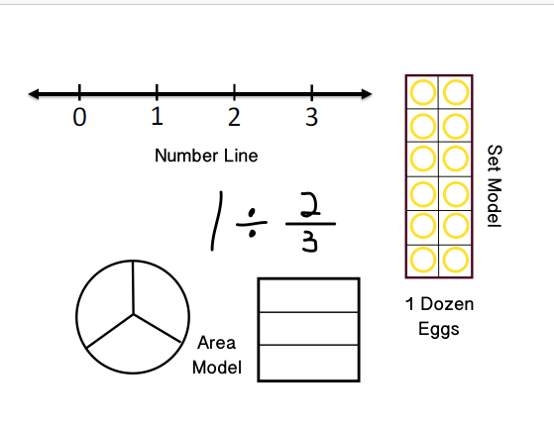
Metacognition and Coherence Using Arrays
Scaffolding Instruction
Cover the Field

Slide 60
Properties of fractions
To add or subtract fractions, we must have the same denominator (why?)
To multiply or divide fractions, we do not have to have the same denominators (why?)

Slide 61
Multiplying fractions (modeling)
$$\frac{2}{3} x \frac{1}{2} =$$

Slide 62
Step 1:
Draw representations of the fractions we are using: $\frac{2}{3} x \frac{1}{2} =$

Slide 63
Step 2:
Transfer marks and portions of one fraction to the other: $\frac{2}{3} x \frac{1}{2} =$

Slide 64
Step 3:
The denominator of the product is the total number of pieces our diagram has:
$\frac{2}{3} x \frac{1}{2} =$
6
1
2
3
4
5
6

Slide 65
Step 4:
The numerator of the product is the number of pieces that are shaded twice:
$\frac{2}{3} x \frac{1}{2} =$
2
6
1
2
3
4
5
6
Notes:
The questions the instructor asks at this point reflect his/her beliefs in what the students can do. The right question can make all the difference! Ask rigorous questions and resist the urge to ask an easier version of the question or answer it yourself!

Slide 66
Step 5:
Finish the problem:
$$\frac{1}{2} x \frac{2}{3} =$$
1
2
or
6
3

Slide 67
Dividing Fractions

Slide 68
Dividing fractions (modeling)
$$\frac{1}{4} ÷ \frac{2}{3}$$
DIVIDEND DIVISOR

Slide 69
Step 1:
Draw a representation of the dividend -- 1/4 and the divisor -- 2/3.

Slide 70
Step 2:
Draw a representation of the dividend -- 1/4 and the divisor -- 2/3.

Slide 71
Step 3:
Transfer the markings from one fraction to the other:

Slide 72
Step 4:
Number the originally shaded tiles - this is your new numerator:
1
$\frac{1}{4} ÷ \frac{2}{3}$ =
3
2
3

Slide 73
Step 5:
Number the tiles shaded by the divisor - this is your new denominator:
1
2
3
4
$\frac{1}{4} ÷ \frac{2}{3}$ =
3
5
8
6
7
8

Slide 74
Step 6:
Combine -
$÷$
$$\frac{1}{4} ÷ \frac{2}{3} = \frac{3}{8}$$
1
2
3
1 2 3 4
5 6 7 8

Slide 75
Activity 2: Area Models
Working together demonstrate how to use a measured area model to solve multiplication of fractions.
Just Choose 2 problems to show a relationship to the traditional algorithm.
You will have 15 minutes.

Slide 76
Areas Models
Putting it all together: Covering the Field and Area Models (Fractions)
Introduce Algebraic Multiplication visually

Slide 77
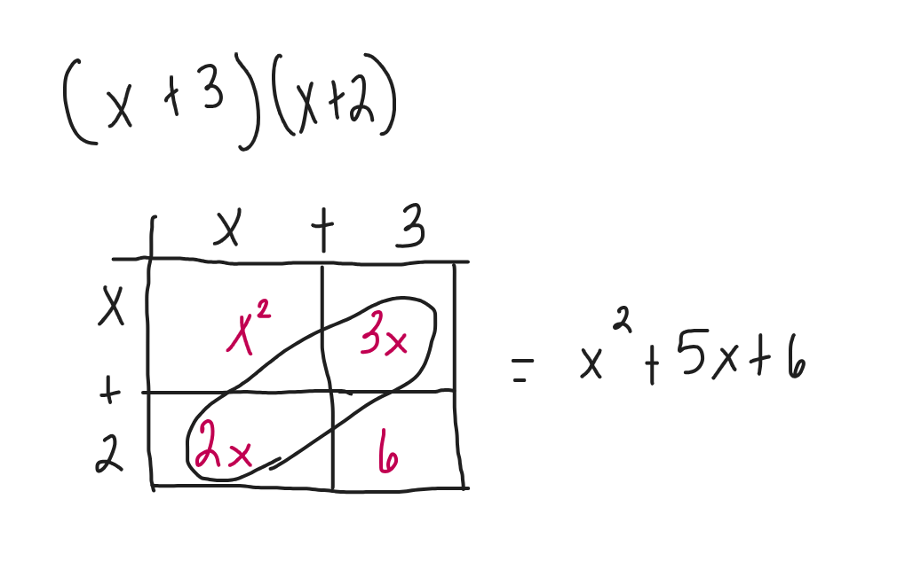

Slide 78
Activity 3 – Area Models Binomial Multiplication
In your groups try the activity
You may use paper at your desk

Slide 79
Debrief
Did you have any “ah-ha” moments?
What skills does this activity build?
Remember Familiarity leads to active learning

Slide 80
Building on Area Models--

Slide 81
Final Thoughts
Believing one’s ability may change over time.
Start with something real and familiar
Try one new thing
Questions?

